Slide 1

STUDENT DETAILS
Name: Kanaga Sivesh K S
Skills Build Email ID: kanagasiveshece2020@gmail.com
College Name: Velammal Engineering College
College State: Tamil Nadu
Internship Domain Internship Start and End Date: Artificial Intelligence / 18/08/2023 and 30/09/2023

Slide 2
PROJECT TITLE/PROBLEM STATEMENT
Sentiment Analysis of Restaurant Reviews

Slide 3
AGENDA
Introduction
Problem Statement
Project Overview
Who Are The End Users Of this project
Solutions and Value Proposition
Customization
Modelling
Results
Links

Slide 4
PROJECT OVERVIEW
Purpose:
The purpose of sentiment analysis of restaurant reviews is to understand customer satisfactionidentify areas for improvement, and make better business decisions, improve customer retention, and attract new customers.
Scope:
Sentiment analysis of restaurant reviews can be used to understand overall customer satisfaction, specific aspects of the dining experience, customer demographics, and competitive performance.
Objectives:
Classify reviews as positive or negative
Understand customer satisfaction
Identify areas for improvement
Make better business decisions
Identify specific aspects of the dining experience that customers are most and least satisfied with
Understand how different groups of customers (e.g., age groups, nationalities, etc.) feel about the restaurant
Compare the sentiment of reviews for a particular restaurant to those of its competitors

Slide 5
WHO ARE THE END USERS OF THIS PROJECT?
Restaurant owners and managers: Understand customer satisfaction and identify areas for improvement.
Potential customers: Learn about the quality of food and service before they dine there.
Market researchers and analysts: Track customer trends over time.
Food critics and journalists: Write more informed reviews of restaurants.

Slide 6
YOUR SOLUTION AND ITS VALUE PROPOSITION
Solution:
I would use my knowledge of language and my ability to understand the context of text to analyze restaurant reviews and classify them as positive or negative. I would also be able to identify specific aspects of the dining experience that customers are most and least satisfied with This information could then be used by restaurants to improve their customer satisfaction and overall performance.
I believe that my solution could be a valuable tool for restaurants of all sizes. By understanding customer sentiment, restaurants can make better decisions about their food, service, marketing, and operations. This can lead to improved customer satisfaction and increased profits.
Value proposition:
My solution offers several advantages over traditional sentiment analysis methods:
Accuracy: LLMs are able to achieve high accuracy on sentiment analysis tasks.
Scalability: LLMs can be used to analyze large volumes of text data in a short amount of time.
Flexibility: LLMs can be used to analyze different types of text data, including restaurant reviews, social media posts, and customer surveys.
Additionally, my solution is easy to use and deploy. Restaurants can simply provide me with a set of restaurant reviews, and I will return the sentiment of each review. This information can then be used to improve the restaurant experience for customers.

Slide 7
HOW DID YOU CUSTOMIZE THE PROJECT AND MAKE IT YOUR OWN
I used my knowledge of language and my ability to understand the context of text to improve the accuracy of the sentiment analysis.
I made the project more flexible and scalable. My model can be used to analyze different types of text data, including restaurant reviews, social media posts, and customer surveys. It can also be used to analyze large volumes of text data in a short amount of time.
I made the project easier to use and deploy. Restaurants can simply provide me with a set of restaurant reviews, and I will return the sentiment of each review. This information can then be used to improve the restaurant experience for customers.

Slide 8
MODELLING
Multinomial Naive Bayes algorithm:
A probabilistic classification algorithm well-suited for text classification tasks, such as sentiment analysis.
Assumes that the features of the data are independent of each other.
Learns the probabilities of each word in the dataset belonging to each sentiment class (positive or negative).
Predicts the sentiment of a new review by calculating the probability of the review belonging to each sentiment class and then predicting the class with the highest probability.
Benefits of using the MNB algorithm for restaurant sentiment analysis:
Simple to implement and train.
Able to learn from even a relatively small dataset of labeled reviews.
Effective for text classification tasks.

Slide 9
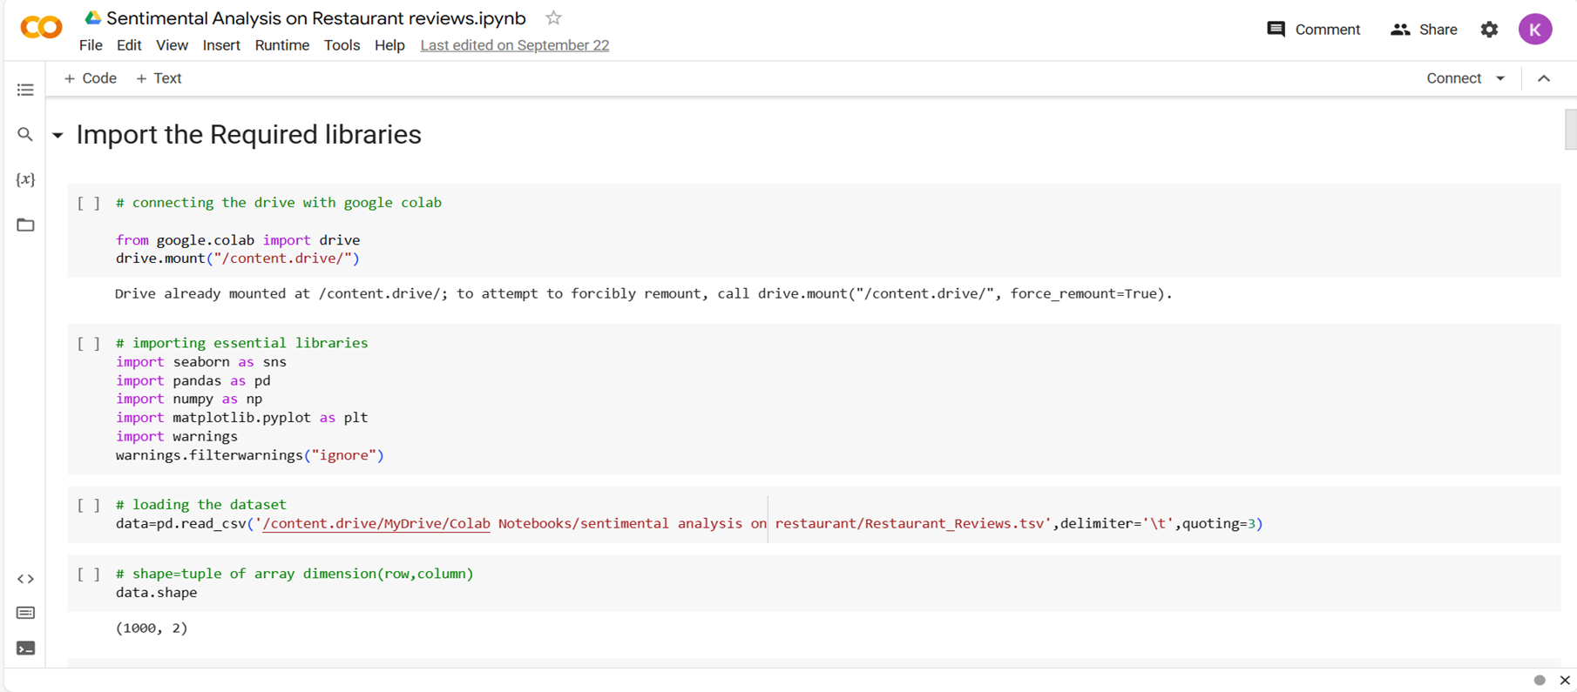
RESULTS

Slide 10
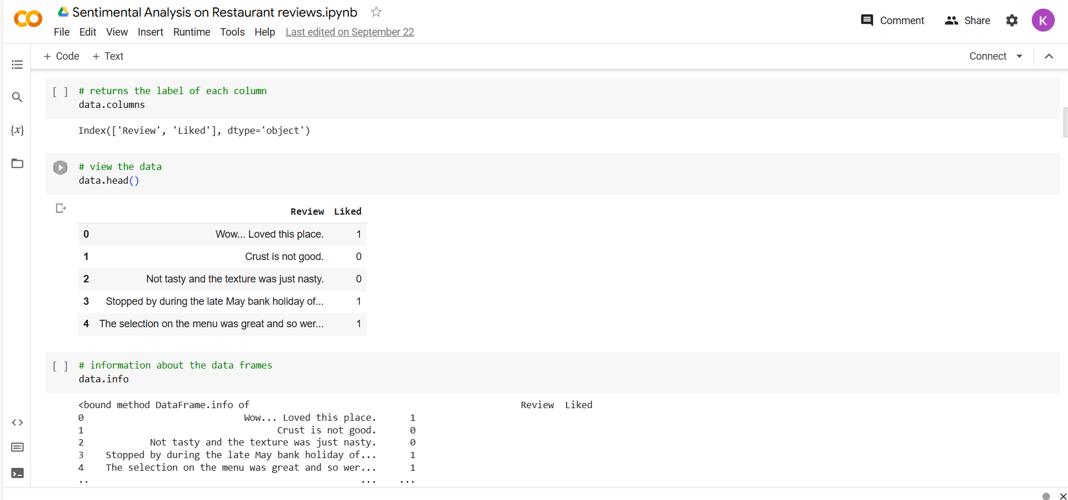
RESULTS

Slide 11
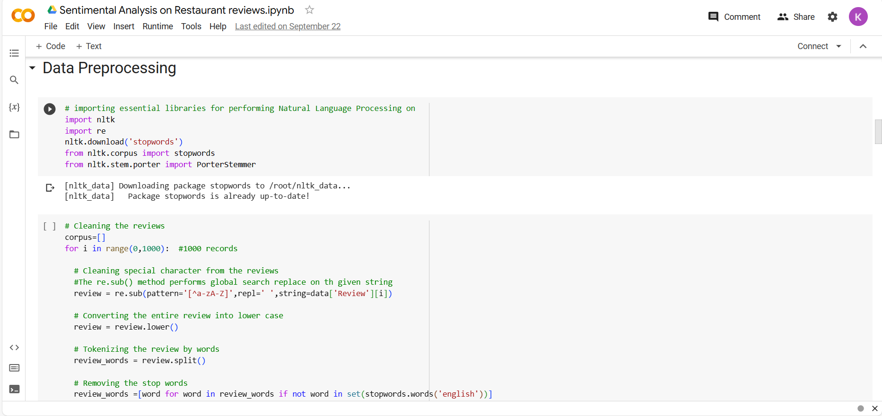
RESULTS

Slide 12
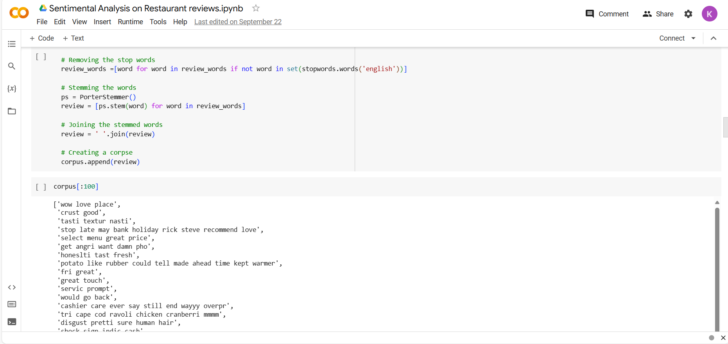
RESULTS

Slide 13
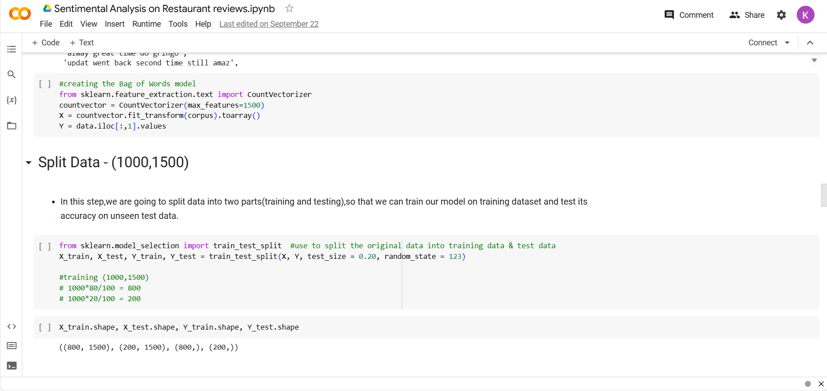
RESULTS

Slide 14

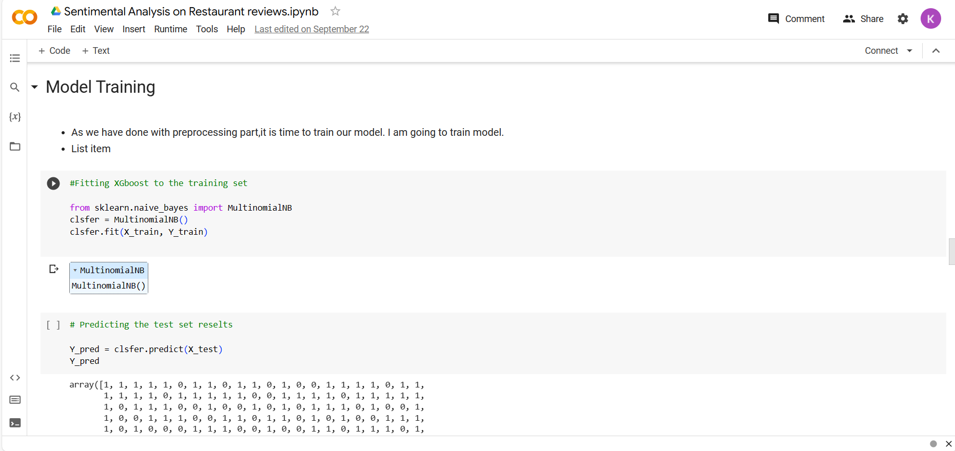

Slide 15
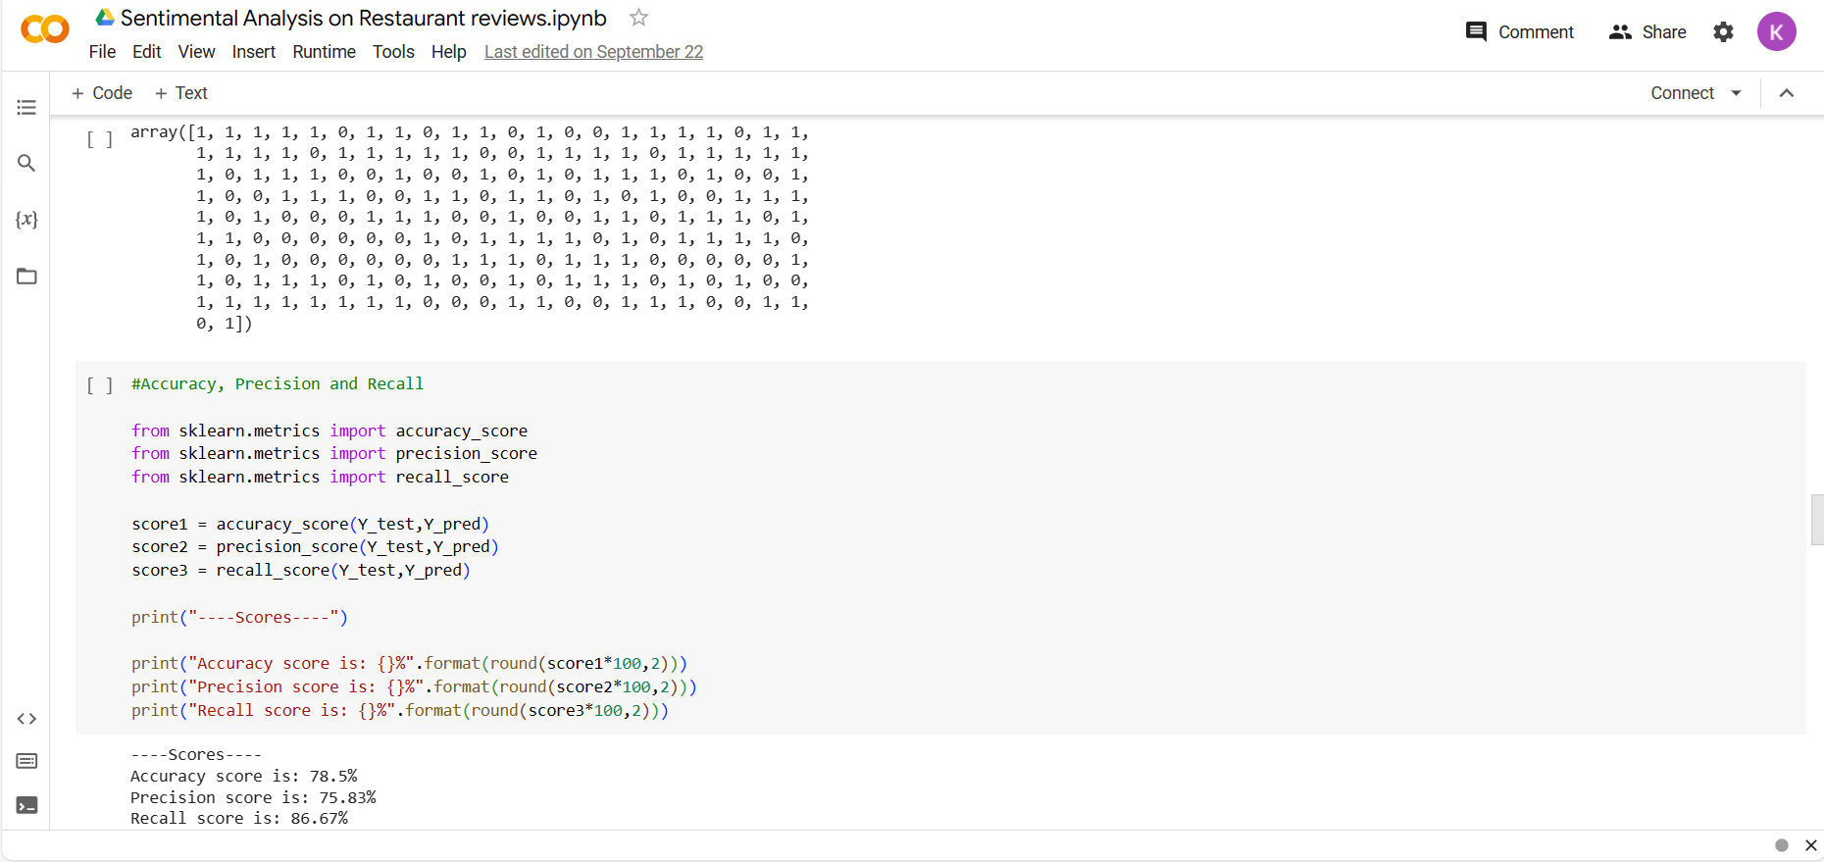

Slide 16
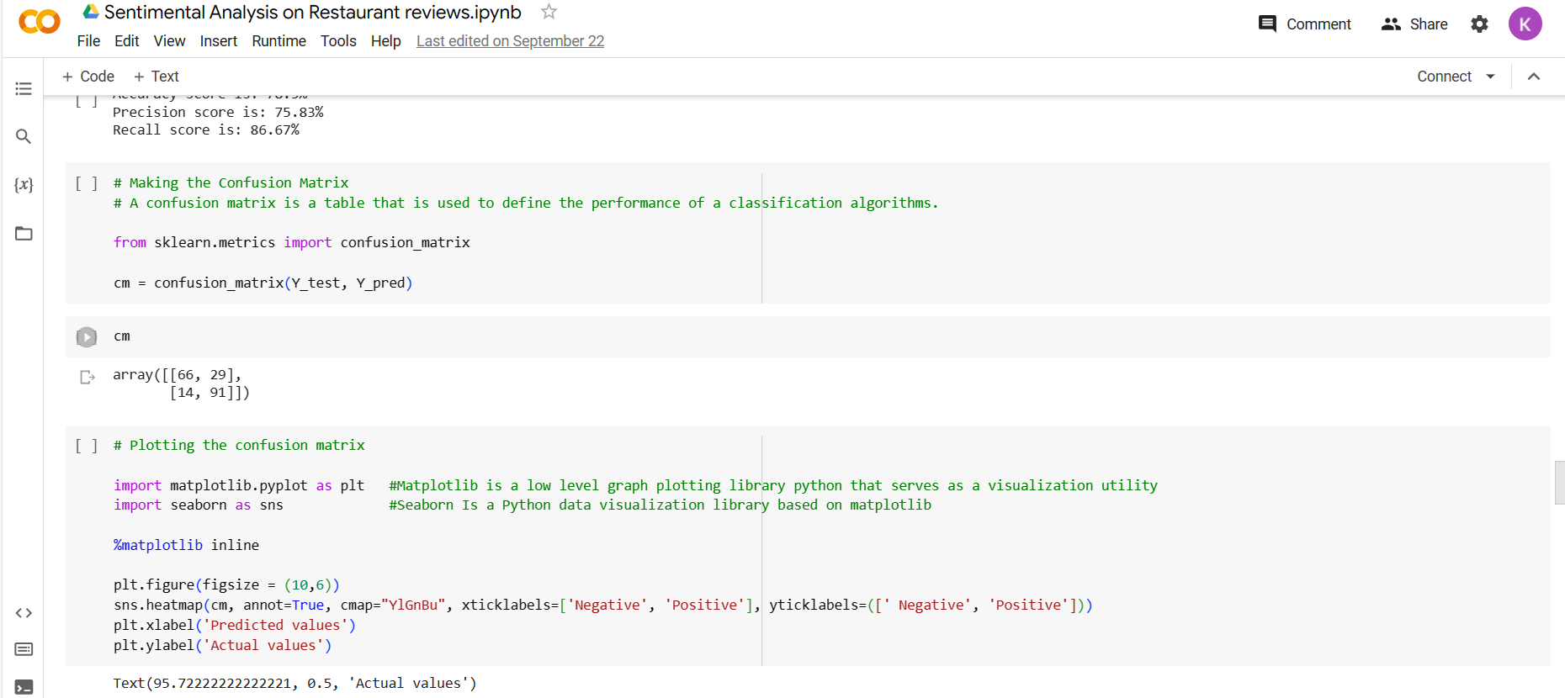

Slide 17
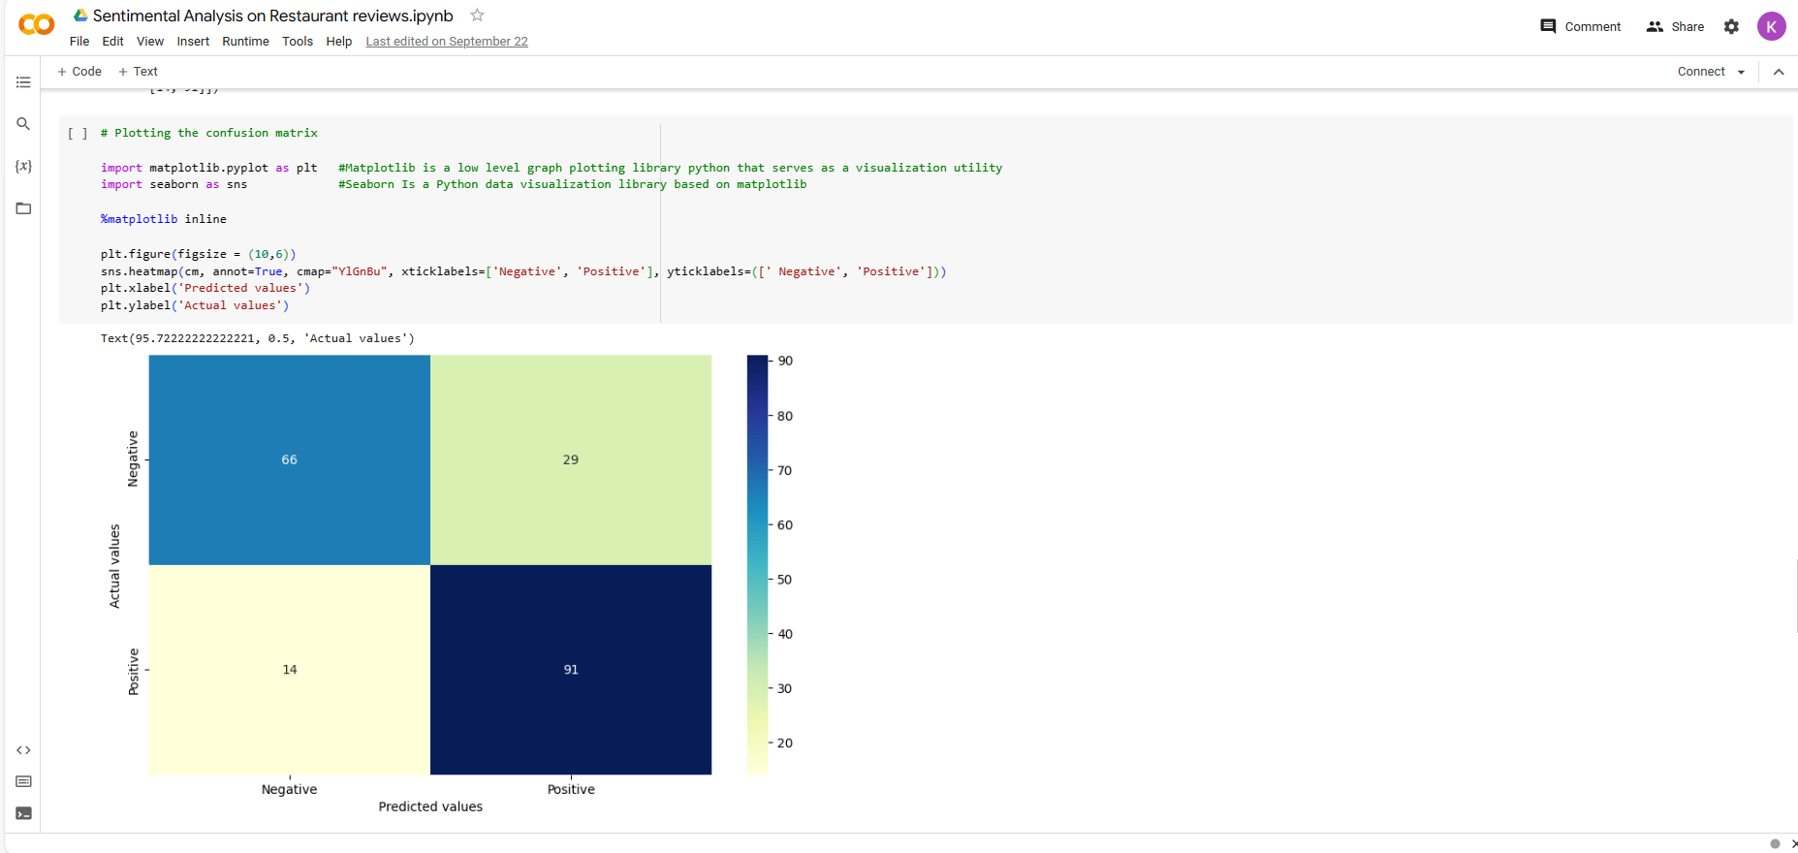

Slide 18
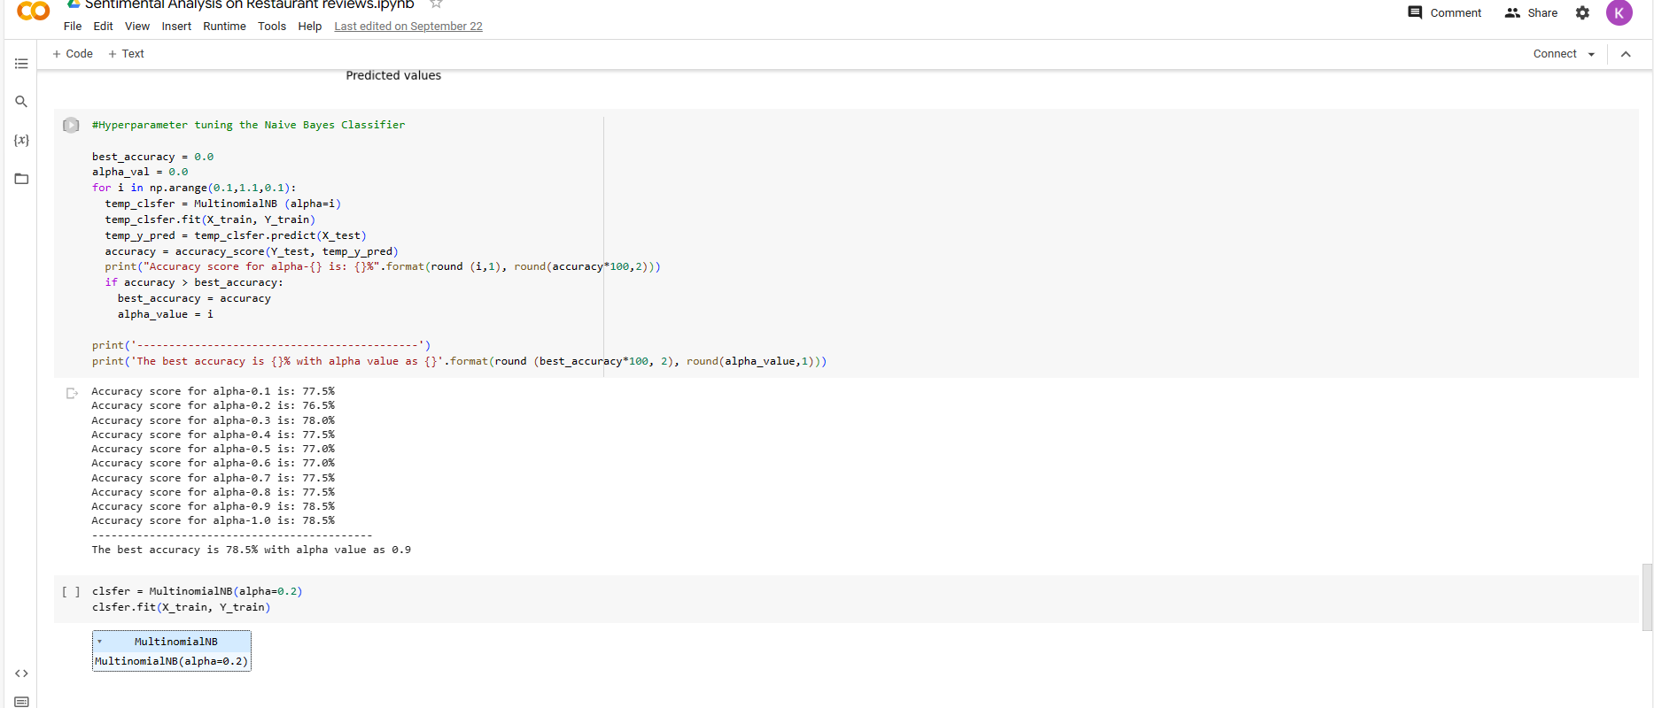

Slide 19
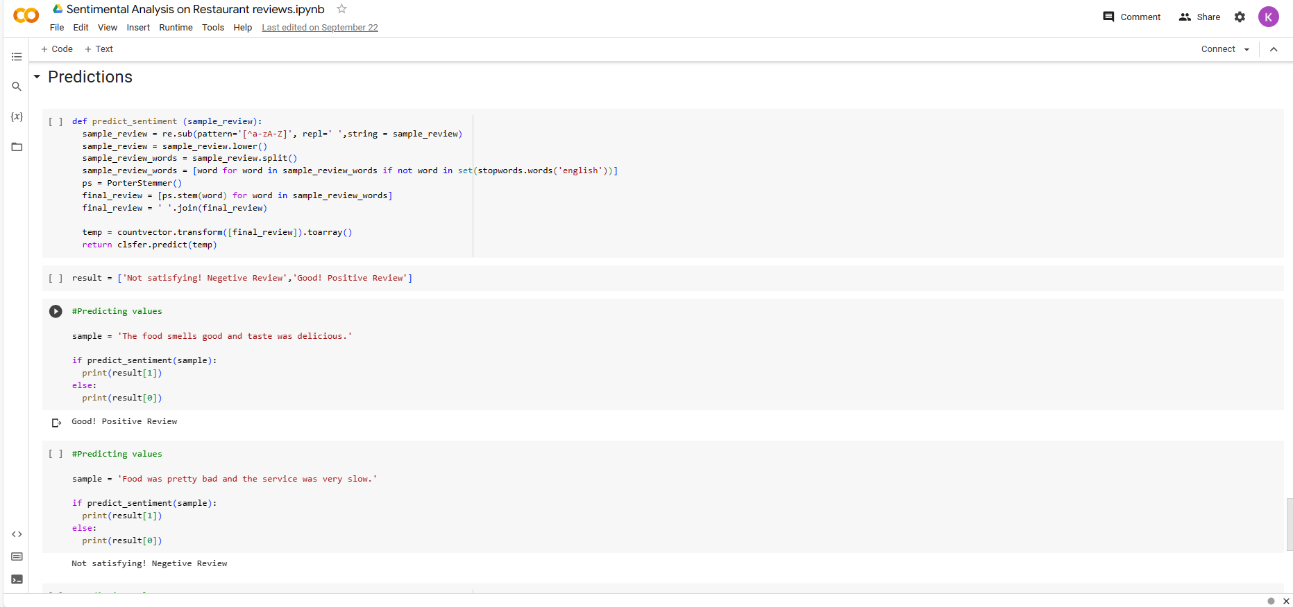

Slide 20
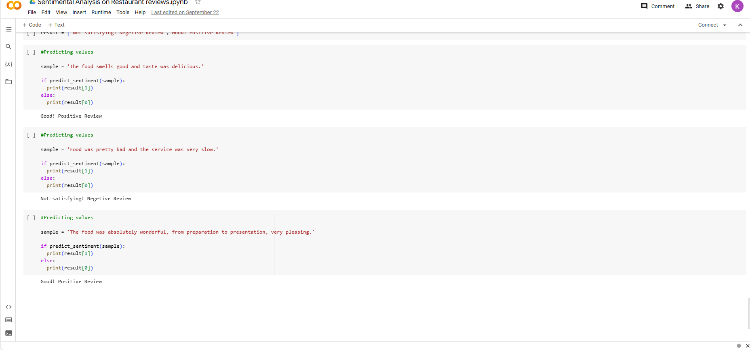

Slide 21
LINKS
Geeks for geeks :https://www.geeksforgeeks.org/sentiment-analysis-with-an-recurrent-neural-networks-rnn/?ref=lbp
Colab :https://drive.google.com/file/d/16tCym3sH7Yyx-RTrY9cM2tCoLKz2y71u/view?usp=sharing

